Slide 1
The New York State Dignity for all Students Act (DASA)
School Team Training
February 2013
Notes:
Before the presentation begins
Distribute the hand-outs
Check projector and sound equipment
Determine the lighting so audience can see the slides and movie clips
Set up room for pair/share or small group sharing (if auditorium use turn and talk)
Leave slide on as participants get settled
Greet participants as they enter the venue
Facilitator introduces him/herself
Say: The New York State Dignity Act requires that every person in a school setting be trained in awareness about bullying prevention and intervention. The law requires that each school building in the state assign a Dignity Act Coordinator.
___________________________ is the Dignity Act Coordinator at our school.
We have a two part presentation for you, presented by Karen Siris, principal of
WS Boardman Elementary School in Oceanside, and a member of the New York State Dignity Act Task Force as the School Administrators’ of New York (SAANYS) representative. There will be some participation from the group and we will pause the film at those times. We will see Part I today and Part II at our next meeting.

Slide 2
Why have 48 states passed anti-bullying/harassment laws? (GLSEN, 2010)
39% of students reported that bullying, name calling, and harassment pose a serious problem at school.
66% reported that people at school were harassed at least “sometimes” because of their looks or body size.
57% reported that students were bullied or harassed “sometimes” because of the way they expressed their gender.
No Law in South Dakota and New Mexico

Slide 3
CYBERBULLYING (Stomp Out Bullying, 2010)
58% of kids say someone has said mean or hurtful things to them online.
53% of kids admit saying something mean or hurtful to another person online.

Slide 4
New York Law THE LAW
Requires districts and schools to prevent, monitor, and address bullying through: (July, 2012)
Designation of a Dignity Act Coordinator to be trained in non-discriminatory instructional and counseling methods and in handling human relationships.
Staff training to raise awareness and sensitivity of school employees to issues of harassment and discrimination.
Sensitivity and tolerance curricula for students.
Revising the code of conduct to create a school environment free from harassment and discrimination .
Reporting of bullying incidents to the state through designated reporting system .

Slide 5
Dignity Act and
Student Curriculum & Instruction
Additional revisions to the statute requires
classroom instruction and curricular connections in the following areas:
Civility
Citizenship
Character
Honesty
Tolerance
Personal Responsibility
Respect for Others
Dignity for All
Notes:
Say: We have many of these traits and attributes in our curriculum now. We do not have to reinvent the wheel, but we do need to make sure that what we are doing now through literature , social studies, health, character education, assembly programs, are identified as supporting the DIGNITY ACT.
Turn and talk about what comes to mind that is in our curriculum.
Do we need to supplement any aspect of this list?

Slide 6
New York State Assembly CYBERBULLYING LAW SIGNED by Governor Cuomo on July 9, 2012 GOES INTO EFFECT 7/2013
Requires all school staff to report any incident of bullying
AND CYBERBULLYING
to the school principal or superintendent
“Cyberbullying has become a dangerous trend and this legislation gives parents and students the tools needed to overcome it,” said Zebrowski. “Standardized policies and procedures will guide teachers and school staff so that they are better equipped to respond to harassment and bullying within the classroom and beyond.” Assemblyman Kenneth Zebrowski (D- New City, NY)

Slide 7
DASA and Task Force on Bullying Prevention Steering Committee
Members consisting of:
Central Office Administrators
School Administrators
Teachers
Support Staff
Pupil Personnel Staff
Parents and Community Members
Law Enforcement

Slide 8
Major Goals/Initiatives
Organize and plan district-wide staff training
Organize and plan school-based DASA Team training
Update district Anti-bullying and Harassment Policy and student Code of Conduct
Create a “DASA culture”
Foster “common language”
Facilitate the creation of “student friendly” versions of the code of conduct
Ensure that district curricula incorporate mandatory instructional requirements

Slide 10
POB CARES!
Video Clip
http://www.pobschools.org//Domain/1

Slide 11
Why Should We CARE?
NYS and Change: The Perfect Storm.
Bullying takes place in every school every day.
The research is clear that when students feel safe at school, they perform at a higher level.
Notes:
Before this video, the audience is asked to make a personal connection to bullying and harassment. The connection can be through
their own experiences in elementary, middle or high school
the experiences of their own children
the experiences of children in their school setting
Optional…. A turn and talk can take place after viewing the clip, or volunteers may want to share their own stories with the group.

Slide 12
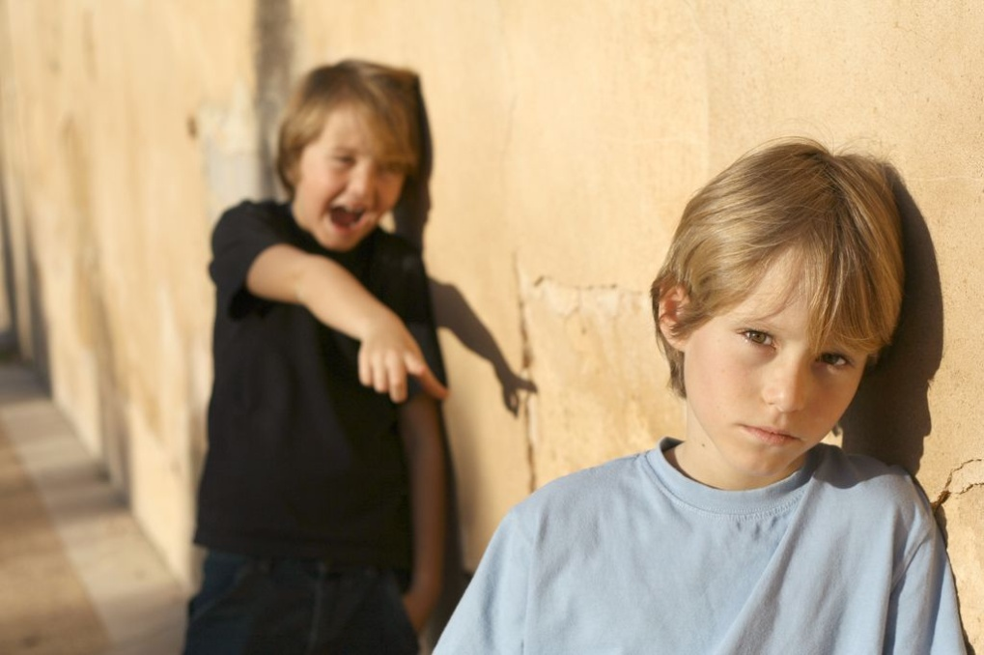
Bullying is a type of harassment
An intentional act of aggression, based on an imbalance of power, that is meant to harm a victim either physically or psychologically.
Usually occurs repeatedly and over time, however sometimes can be identified in a single event.

Slide 13
Developing Common Language
THE BULLY
THE TARGET/VICTIM
THE BYSTANDER
THE UPSTANDER

Slide 14
A person who intervenes when s/he witnesses intolerance; someone who makes a stand against bullying.
Upstander

Slide 15
Adults Can and Do Make A Difference
The research shows that where bullying is not an issue, EVERY child has at least one adult that they feel comfortable talking to.
Work to be that one person!
POB CARES!!!

Slide 16
The Role Of The School Team
The “brain trust” that keeps this initiative moving forward at the school level
Support
Sharing with colleagues

Slide 17
What Still Needs To Be Done?
Continued focus, commitment, and training
Finish DASA to local curriculum mapping
Code of Conduct – “…providing copies of a summary of the code of conduct to all students, in an age-appropriate version, written in plain-language…”
Elementary version
Middle School version
High School version
Brainstorming…

Slide 18
Thank-you for your attention and help in ending bullying and harassment in our schools.

